Slide 1
Headings
Page <number>

Slide 2
What do headings accomplish?
Headings enhance readability, scan-ability, and overall professionalism of the document:
Provide an overview (Table of Contents)
Indicate the logical flow and hierarchy of ideas
Enable readers to read selectively
Provide breaks and white space
Keep readers focused
Keep the writer focused and organized
Page <number>

Slide 3
Tips for designing headings
To indicate hierarchical importance of different levels of headings, use
  Numbering system
  Font type and size
  Bold and italics
  Placement (indentation)
Be consistent in using one size/style/font for each heading on the same level (use Styles function in MS word)
Use a numbering system to indicate hierarchical importance of headings and flow in longer documents
Font size and typography is used intuitively:
      (larger size or bold = more emphasis)
Page <number>

Slide 4
Example Heading Designs
Heading: Arial bold 16 point font. Introduce with Arabic numeral; aligned with left margin. 1.5 space below (whitespace between heading and text below it)
1. Heading Level One
This is text. This is text. This is text. This is text.
This is text. This is text. This is text. This is text.
This is text. This is text. This is text. This is text.
This is text. This is text. This is text. This is text.
Body font: 12 point Times New Roman
Page <number>

Slide 5
Heading Designs: Second Level
Leave white space under the end of the previous section. There should always be slightly more white space above the heading than below.
    1.1. Heading Level Two
    This is text. This is text. This is text. This is text.
    This is text. This is text. This is text. This is text.
    This is text. This is text. This is text. This is text.
    This is text. This is text. This is text. This is text.
Heading and text is indented 0.5” from margin;
Arial bold 14 point font; introduced with numeral and one decimal place.
Page <number>

Slide 6
Heading Designs: Third level
Additional indent from margin (optional). Font Times New Roman bold italics 14 points. Introduce with an Arabic numeral
1.1.1. Heading Three
      This is text. This is text. This is text. This is text.
      This is text. This is text. This is text. This is text.
      This is text. This is text. This is text. This is text.
      This is text. This is text. This is text. This is text.
Page <number>

Slide 7
  1. First Level Heading
  Under this first level heading you will find text related to the topic indicated by the heading. It will go on for several lines. If there is a Section 1, there will also be a Section 2 in order to avoid having a lone heading at this level.
    1.1. Second Level Heading
    This section may align directly under the 2nd level heading, or
    can align with the left margin. To avoid having a lone heading at this level, you will also have a section 1.2 and possibly 1.3, etc.
      1.1.1. Third Level Heading
      This third level heading is further indented, and smaller or
      In italics to set it off from second level heading. Again, if
      You have a 1.1.1, you should have a number 1.1.2, etc.
      1.1.2. Additional Third Level Heading
      Text text text text…
    1.2. Additional Second Level Heading
    Text, text text…
  2. First Level Heading with a New Topic
  Text text text text…

Slide 8
Non-Numbered Headings Example:
  First Level Heading
  Under this first level heading you will find text related to the topic indicated by the heading. It will go on for several lines. You will have additional headings at this level in order to avoid creating a lone heading.
    Second Level Heading
    This section may align directly under the 2nd level heading, or
    can align with the left margin. To avoid having a lone heading at this level, you will have additional headings at this level.
      Third Level Heading
      This third level heading is further indented, and smaller or
      In italics to set it off from second level heading. Again, if
      You have a 1.1.1, you should have a number 1.1.2, etc.
      Additional Third Level Heading
      Text text text text…
    Additional Second Level Heading
    Text, text text…
  First Level Heading with a New Topic
  Text text text text…
Page <number>

Slide 9
How do you use headings?
Each section must have a heading, and each heading should normally have text under it.
Use consistent formatting (Use STYLES) for each level of heading
Make your headings accurate and descriptive
Use task-oriented headings in instructions
Have more white space above the heading than below
Use an appropriate number of headings
  Guideline: 2 to 4 headings per page for our assignments
Page <number>

Slide 10
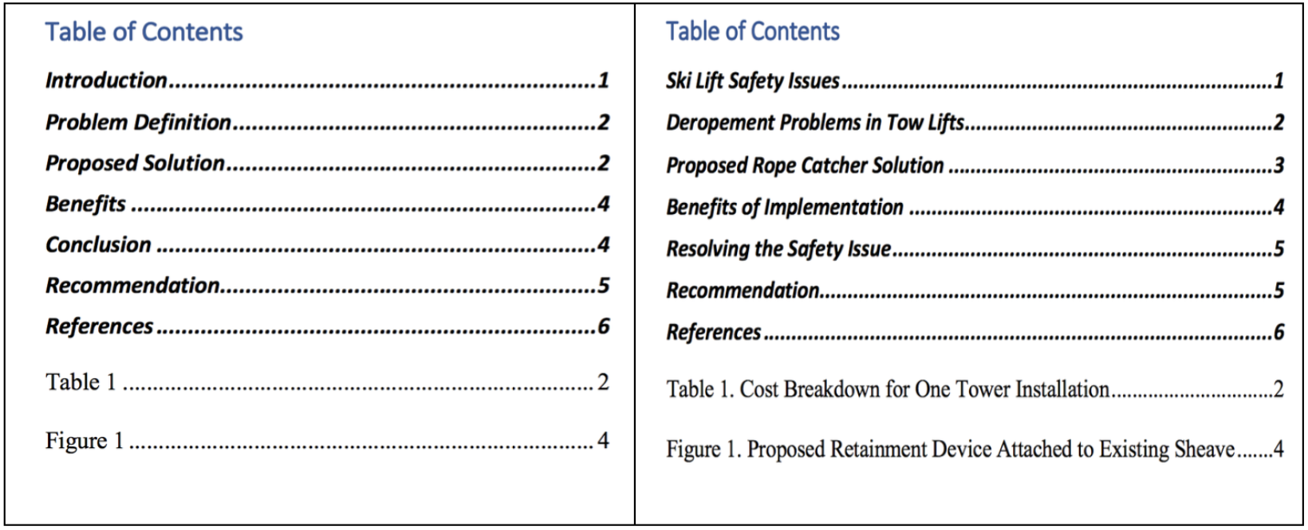
Function vs Descriptive Headings
These two tables of contents are based on the documents’ headings. Which table gives you a better sense of what the document contains?
Page <number>

Slide 11
What to Avoid
Lone headings | Avoid having just one heading at a particular level or section of your document. That is like having one item in a list.
Stacked Headings | Every heading should normally have body text under it.
Headings as list lead-ins | A list should be introduced by a grammatically correct lead-in sentence.
Headings as captions for visuals | Use “insert caption” to create correct labels for figures and tables, and place them appropriately. Headings indicate an entire section, not a single visual element.
Widows and Orphans | Use hard page breaks to avoid leaving a heading orphaned at the bottom of a page, with no text below it.

Slide 12
Quick Quiz
Identify three things that headings accomplish.
What are “stacked headings” and when should these be used?
True or false? “Background” or “Technical Information” are examples of effective descriptive headings.
What is a lone heading?
Can a heading introduce a table?
True or false: 3rd level headings should be larger than first level headings?
True or false? There should be more white space above the heading than below?
Page <number>

